Slide 1
Implementing a RNN accelerated MLFQ scheduler on an FPGA
Levi Redlin
UW Computer Science 2022

Slide 2
Background
Multilevel Feedback Queue(MLFQ) process scheduler uses multiple queues with assigned priorities and runs the processes in a queue for a set time quantum
Intelligent Multilevel Feedback Queue(IMLFQ) algorithm was introduced in 2006 by Mohammad Reza Effat Parvar et al. at Azad University of Qazvin
IMLFQ uses a Recurrent Neural Network(RNN) to determine the number of queues for the MLFQ algorithm and the time quantum for each queue with a goal of minimizing average turnaround time
The Leflow library was introduced by Daniel Noronha et al. in 2018 and it provides the ability to automatically generate synthesizable Verilog from Tensorflow Neural Network models to program the networks onto FPGAs
My project is concerned with leveraging both newer technologies to create a fast scheduler with hardware support

Slide 3
Using Neural Networks for process scheduling
Neural networks can predict the CPU time a process will need for completion and can infer optimal metrics in complex scheduling algorithms such as the number of queues and time quantum for the MLFQ algorithm
Benefits of Recurrent Neural Networks(RNN) on time-series based datasets prove to be especially useful given the dynamic nature of process scheduling
Neural Networks can be modelled to account for undesirable occurrences such as process starvation

Slide 4
FPGA vs GPU vs ASIC for Machine Learning
Application-Specific Integrated Circuit’s(ASIC) are chips that are customized for a single application, providing an extremely fast and reliable ML implementation
ASICs provide no flexibility as they can’t be reprogrammed
GPUs provide excellent parallel processing capabilities and provide flexibility to run any software defined neural network implementation
GPUs are slower than ASICs for specific applications and can consume large amounts of energy
FPGAs provide low latency and high throughput by directly performing necessary computations on hardware
FPGAs can be reprogrammed, providing flexibility compared with ASICs
FPGAs offer reduced power consumption compared with GPUs
Notes:
Main FPGA challenge is programming them, which is being made easier

Slide 5
Bringing it all together
Dataset generation is done by creating a CSV file with a bash script that uses the sizes of RO data, Text data, BSS data as features and the processes CPU time as output
For testing, simple C programs that do various common operations are used
These data inputs are saved for each process using the Linux time, readelf and size commands on executable files
Neural Network implementation and pre training is done in Python using Tensorflow
Once pretrained, the RNN input and output are sent and received through a network call to the FPGA
The results from the RNN are utilized in a process scheduler currently being simulated in C++
Notes:
Potential for kernel patch in future on systems already using MLFQ
Features may change throughout project

Slide 6
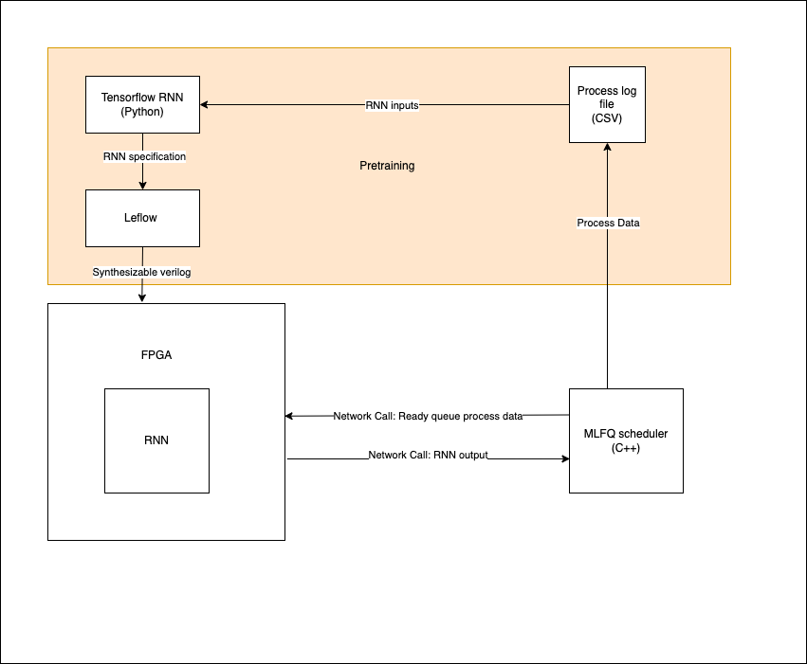

Slide 7
Questions?

Slide 8
References
Effat Parvar, Mohammad Reza & Effat Parvar, Mehdi & Haghighat, Abolfazl & Mahini, Reza & Zarei, Mahdi. (2006). An Intelligent MLFQ Scheduling Algorithm (IMLFQ).. 1033-1036.
Noronha, Daniel H., Bahar Salehpour, and Steven JE Wilton. "LeFlow: Enabling flexible FPGA high-level synthesis of tensorflow deep neural networks." FSP Workshop 2018; Fifth International Workshop on FPGAs for Software Programmers. VDE, 2018.

